Slide 1

Sastodeal.com
Case study
By Omkar Basnet
Prajwal Thakuri
Pramod Aryal
Pooja Neupane
Pretesha Giri

Slide 2
INTRODUCTION
E-commerce is the process of buying and selling of goods and services, over an electronic network, through the internet. E-commerce is now major part of internet. In context of Nepal, it is noted that 63% of total population uses internet service.
SastoDeal.com is one of the example of E-commerce based company in Nepal. SastoDeal.com is one of the biggest online shopping website after Daraz. It provides most of the needed accessories, by making least chance of disappointing costumers, and it believes in transparency and honest communication between vendor and costumers. With internet users on the high rise, Nepal is moving towards a digital revolution. As well as it provides different type of facilities such as; Home delivery, return and exchange with warranty on valuable things.

Slide 3
How SastoDeal.com works ?
It is a form of business which allows consumers to directly buy goods or services from a seller over the internet using a web browser. By visiting the website directly or by searching among alternative vendors using a shopping search engine consumers find a product of interest. It also provides the information about all the product related with it such as, product availability and pricing different e-retailers and features. As well as it also enable shoppers to use “search” features to find specific brands model or items.
In sastodeal.com it allows to customers to do the payment through credit card , debit card or a service such as esewa or khalti (same like PayPal)etc. After completing the session of order and response of customer it deliver the order product as its time and rules.

Slide 4
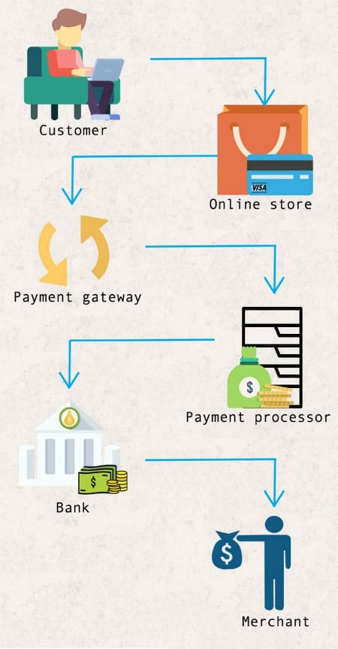
Procedure in figure

Slide 5
How sastodeals.com helps for uplifting the living standard of people and country ?
Nepal is slowly moving towards the direction of digital revolution. Due to online shopping shoppers aren’t needed to stay or wait in traffic, bargain for discount and spend hours looking for the products and services that they want. All it takes few time and few session to order the product and place to order. Due to which the way of shopping is changed, people can get the best thing or branded item in best price as want. As they get their product on needed time without staying in traffic and bargain which helps them to utilized their time on other works.
Due to online shopping country also getting benefit directly or indirectly . It means government can control unusual pricing rate and cheating on VAT, if online shopping website is being implement as well as, if people of the country were bring modernized. Then, it also helps for uplifting the country etc. Due to the following way it helps for uplifting the living standard of people and country.

Slide 6
advantage
It makes the process of buying and selling procedure faster and safe due to its protective session for transaction.
It minimize the effect of shoppers for searching different goods in different place by allocating every goods on one platform call online shopping(sastodeal.com).
It allocate best price in goods due to which it minimize the bargaining process.
It also helps to save money and time because of free delivery and no longer have to wait in traffic to reach the shop.
It also make a best way to find every product due to which needed people can easily get.

Slide 7
Disadvantage
Fraud in online shopping is the biggest disadvantage of online shopping. Many people are attracted towards great offer which seems good but usually not. Likewise, customers debit and credit card are misused to make fraudulent transactions.
Lack of touch and feel for the merchandise in online shopping.
Online shopping is not quite suitable for clothes as the customers cannot try them which create the problem of perfect size.
Lack of close examination in online shopping which creates the problem of color and quality due to various reason.
Delay in delivery; we cannot get the product in hand immediately after payment . so, we have to wait for some days or week sometimes a month too.
Hampers sales of retails shop; Online shopping also hampers retails shop, Nowadays, people are mostly engaged in it to save time etc.

Slide 8
Conclusion
Everything is not bad in itself, it depends upon the user. How he is using it?
Its like a boom for us. It was developed for us for our benefit as well as while doing such work always be careful regarding about threads, misuse of card etc and take more and more benefit form it

Slide 9


Slide 10


